Slide 1


Computer Vision project: Indoor SLAM
Shalygin Igor, Tsoy Anton, Kozlov Kiril
NSU FIT, 2024

Slide 2

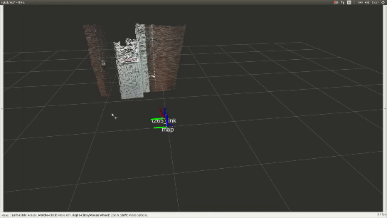
What Indoor SLAM is

Slide 3

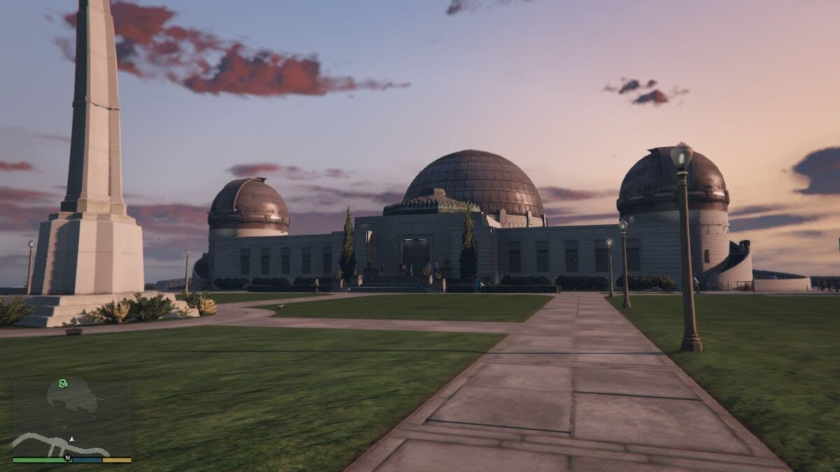
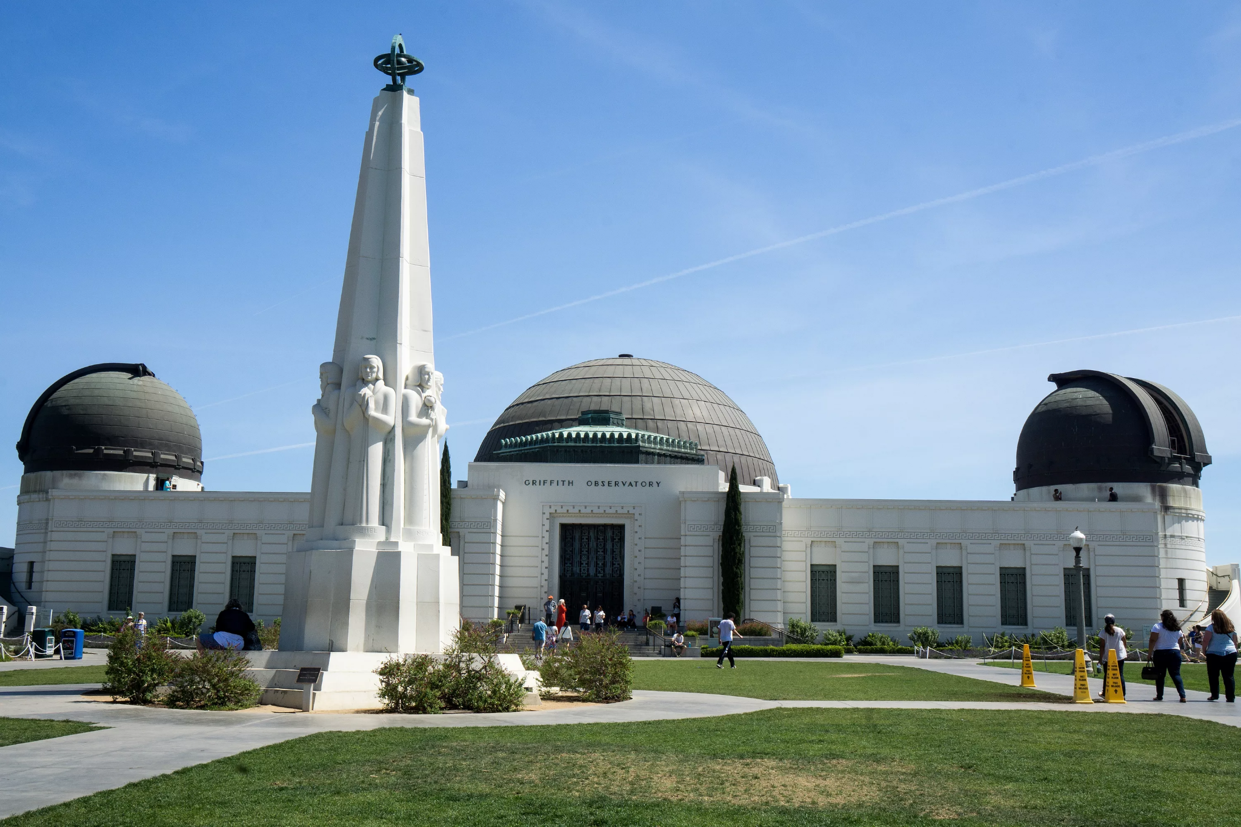
The relevance
GTA 5
Real life

Slide 4



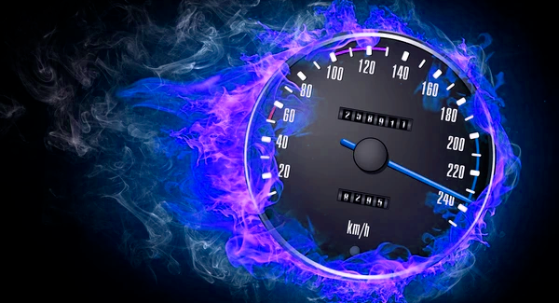
Implement Indoor SLAM
Opencv has a lot of built-in functions we need
C++ can give us high processing performance
This combination gives a great programming challenging experience
+

Slide 5
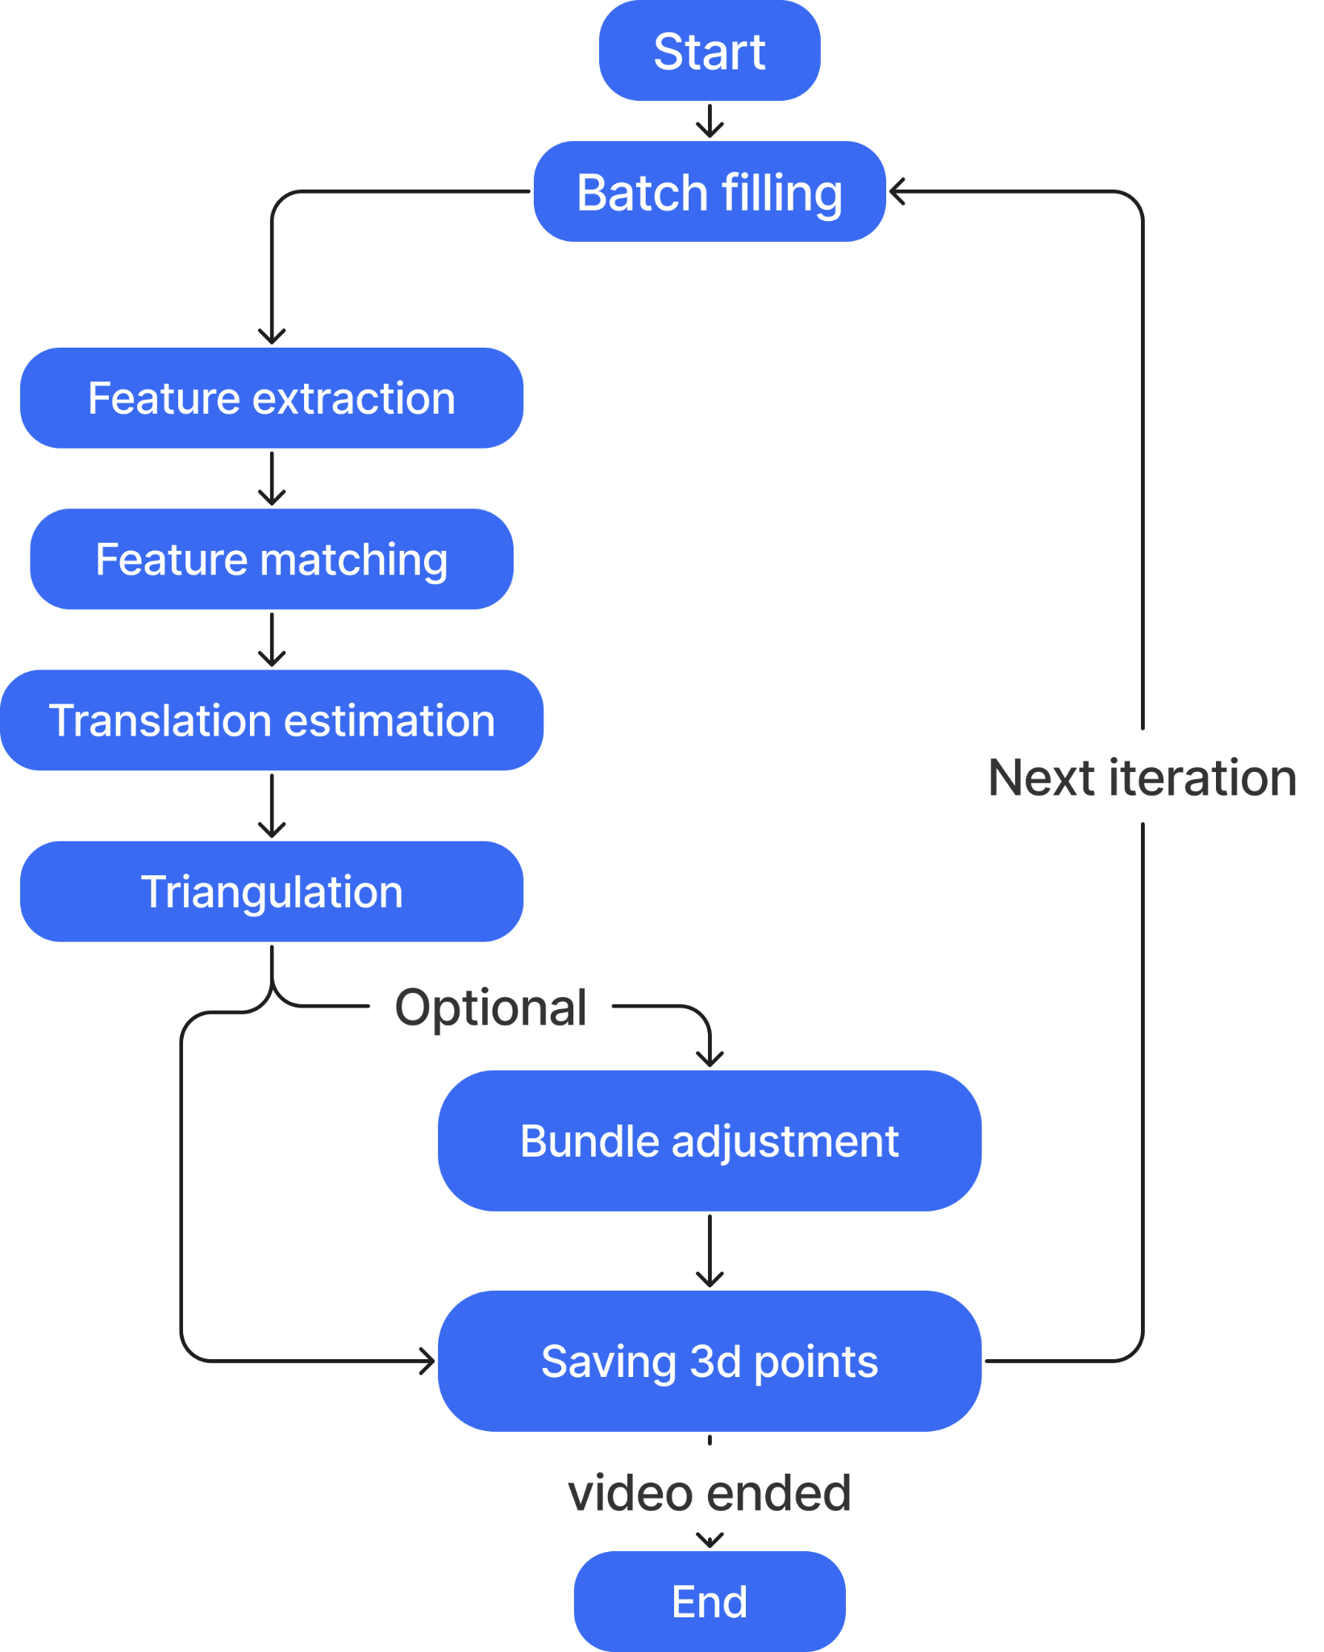

Slide 6
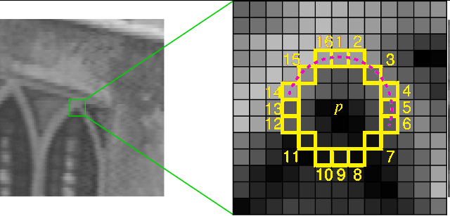
Feature extraction
Choose candidate pixel P
Compare the intensity with circle
EXTRACT
SKIP

Slide 7
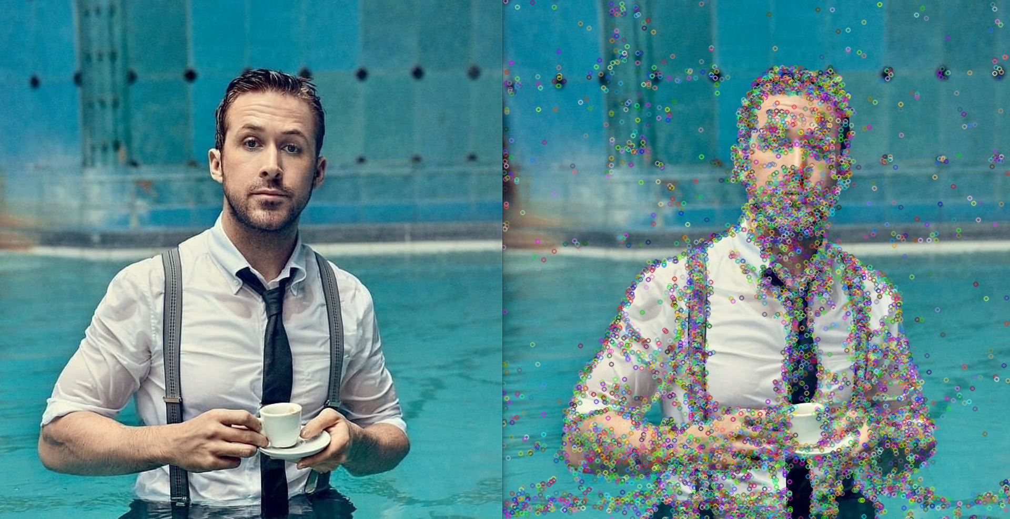
Feature extracting

Slide 8

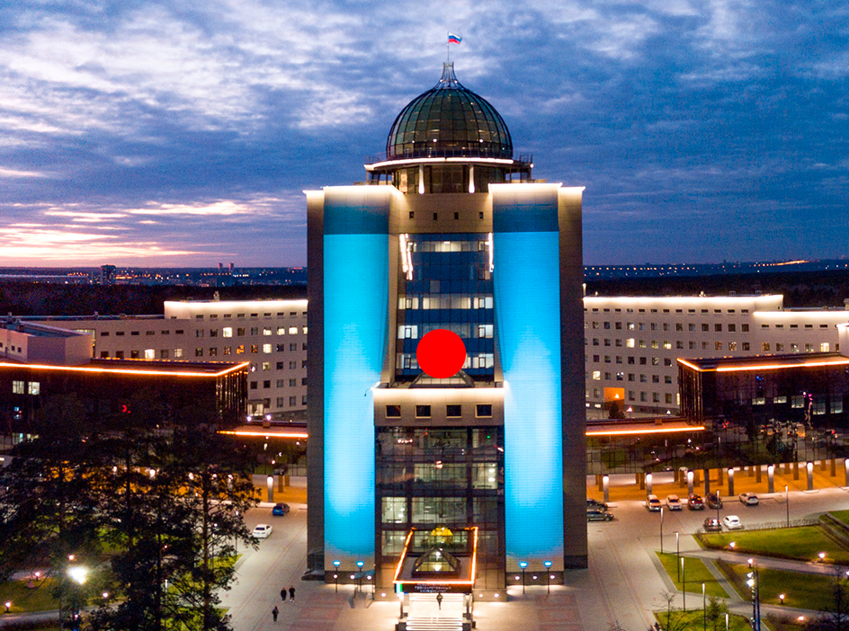
Feature tracking using
Least Sum of Differences algorithm
We propose feature in the second frame moved within some search region with radius R.
The feature’s search region.

Slide 9
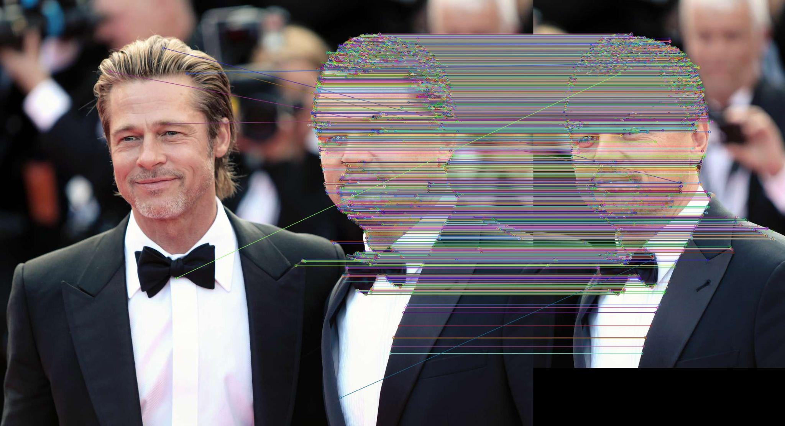
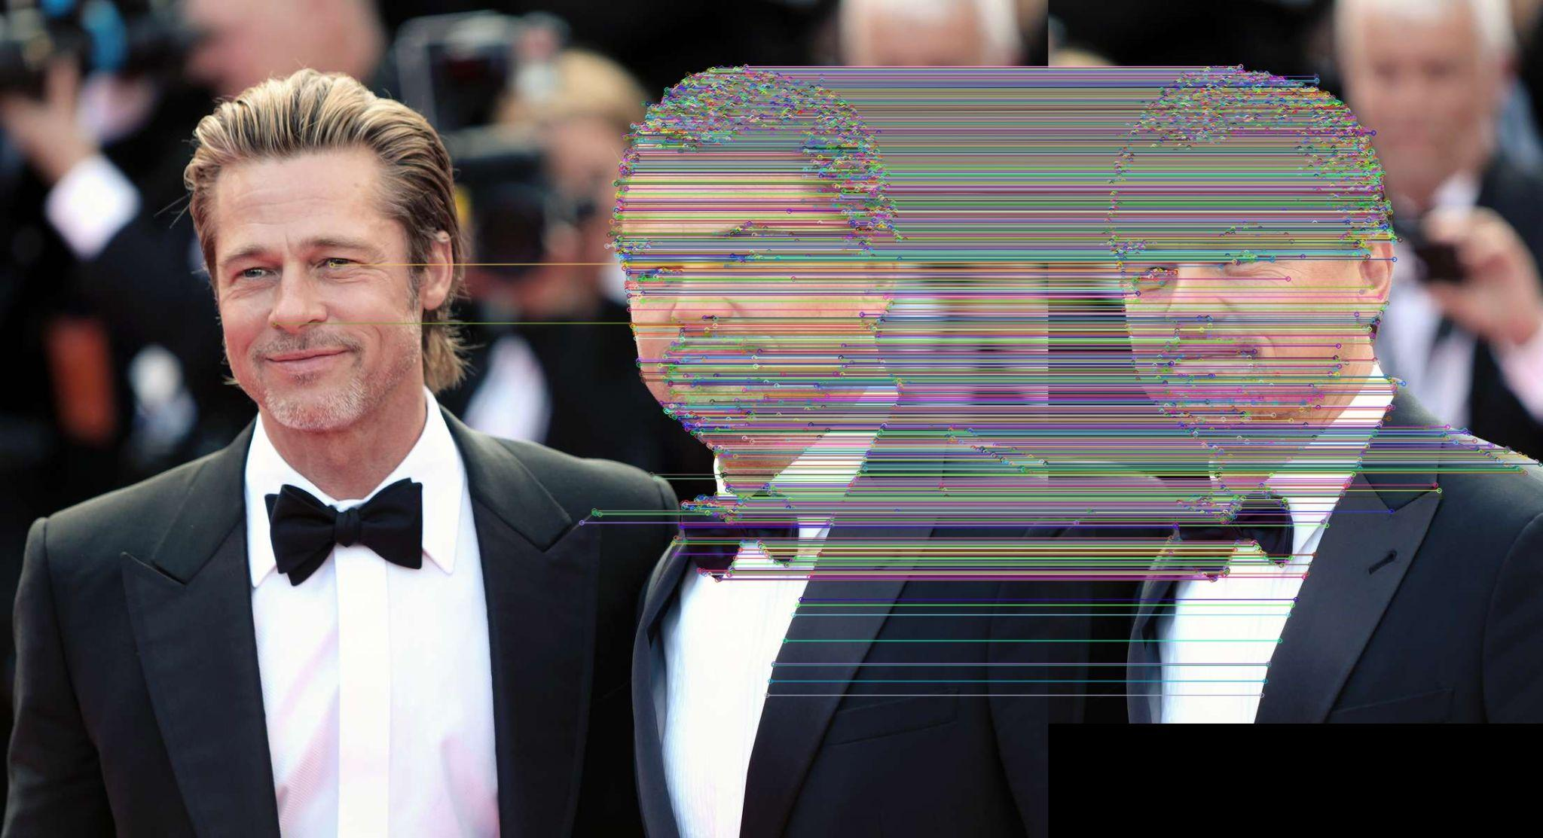
Feature matching
Brute-Force matching with ORB descriptors
FLANN based matching with SIFT descriptors

Slide 10

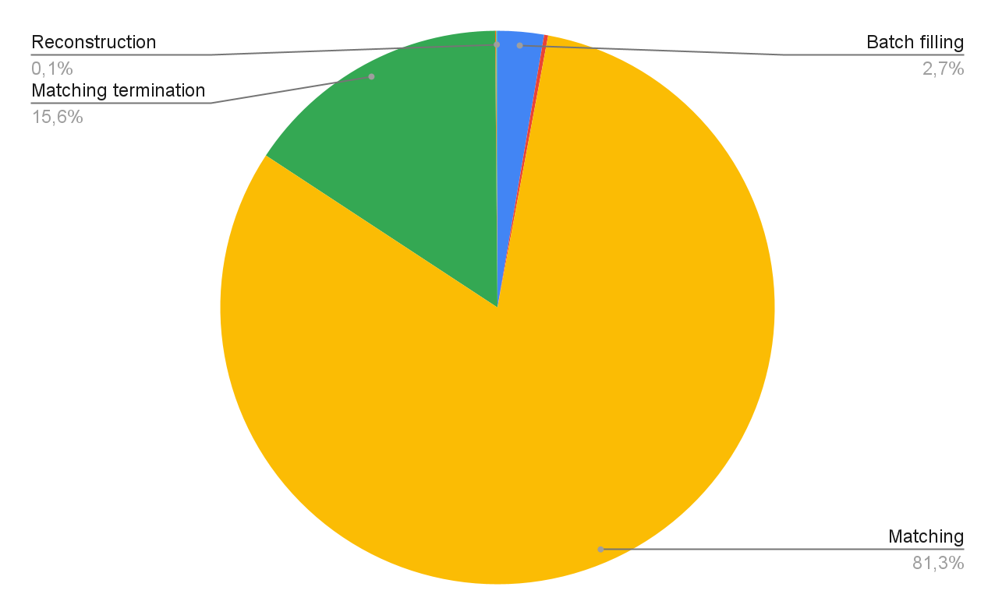
Time distribution

Slide 11
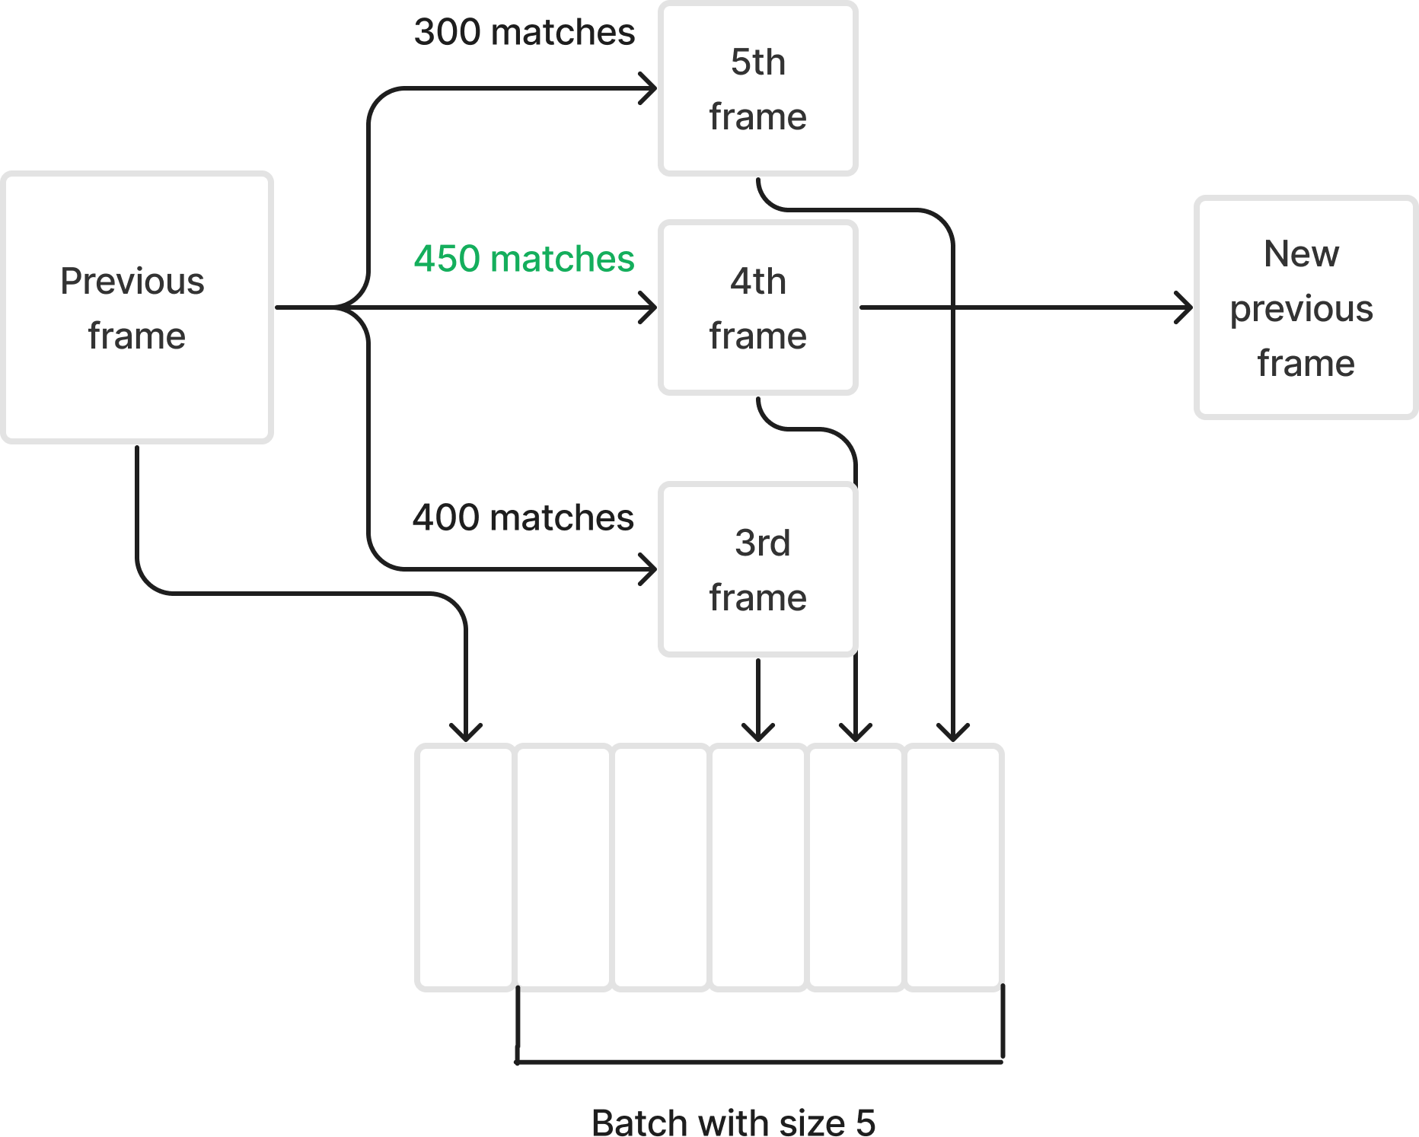
Multithreading
3 threads example

Slide 12

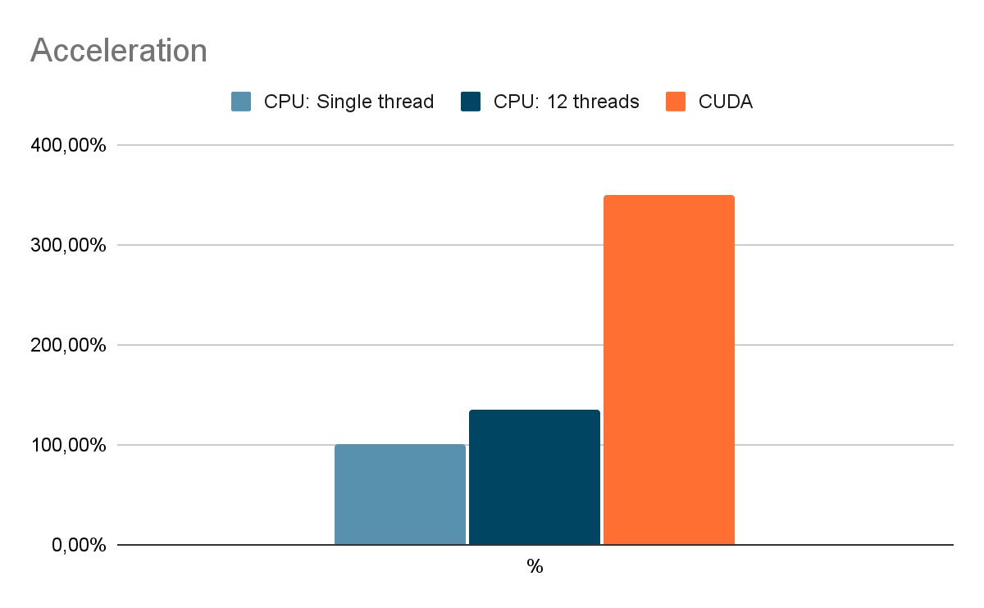
Acceleration results

Slide 13
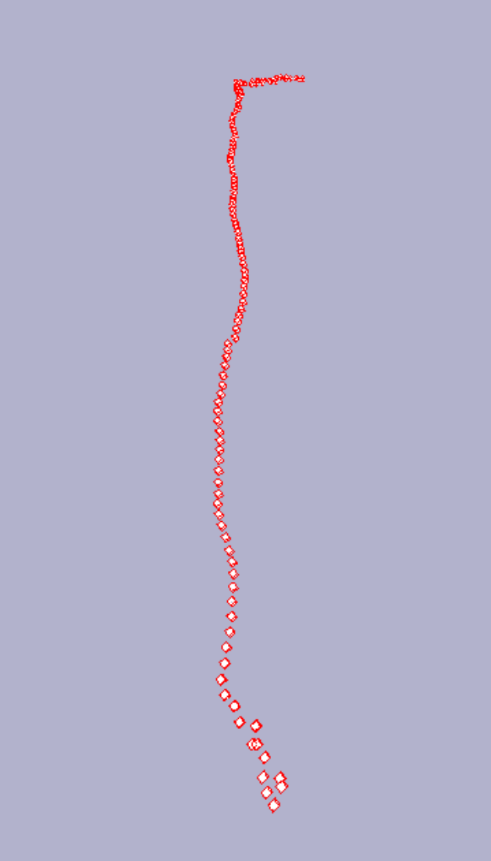
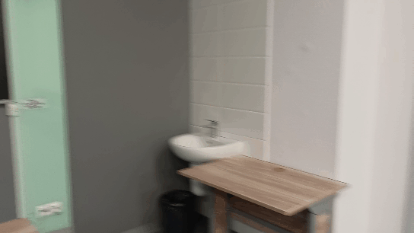
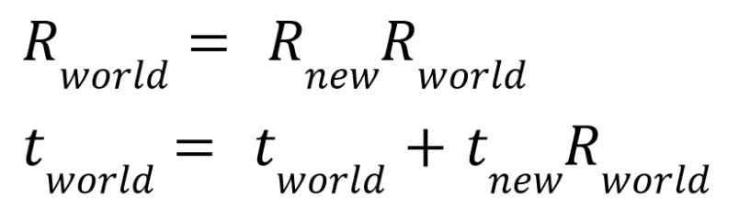
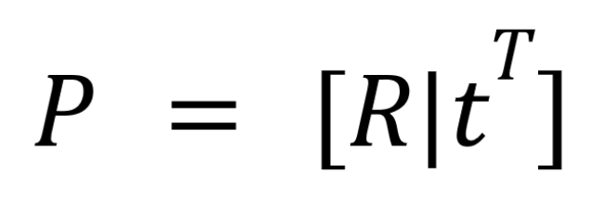
World positions: basics
Projection matrix
Refining translation data

Slide 14
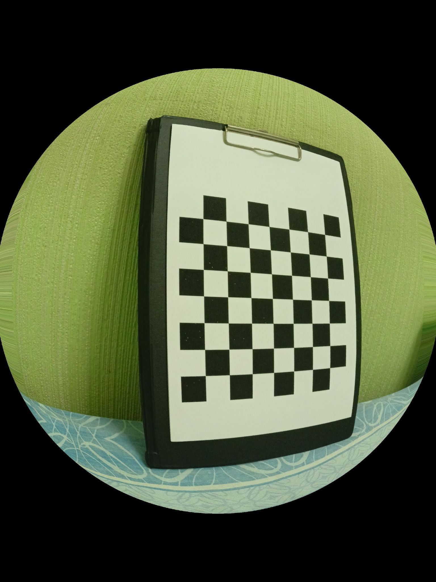
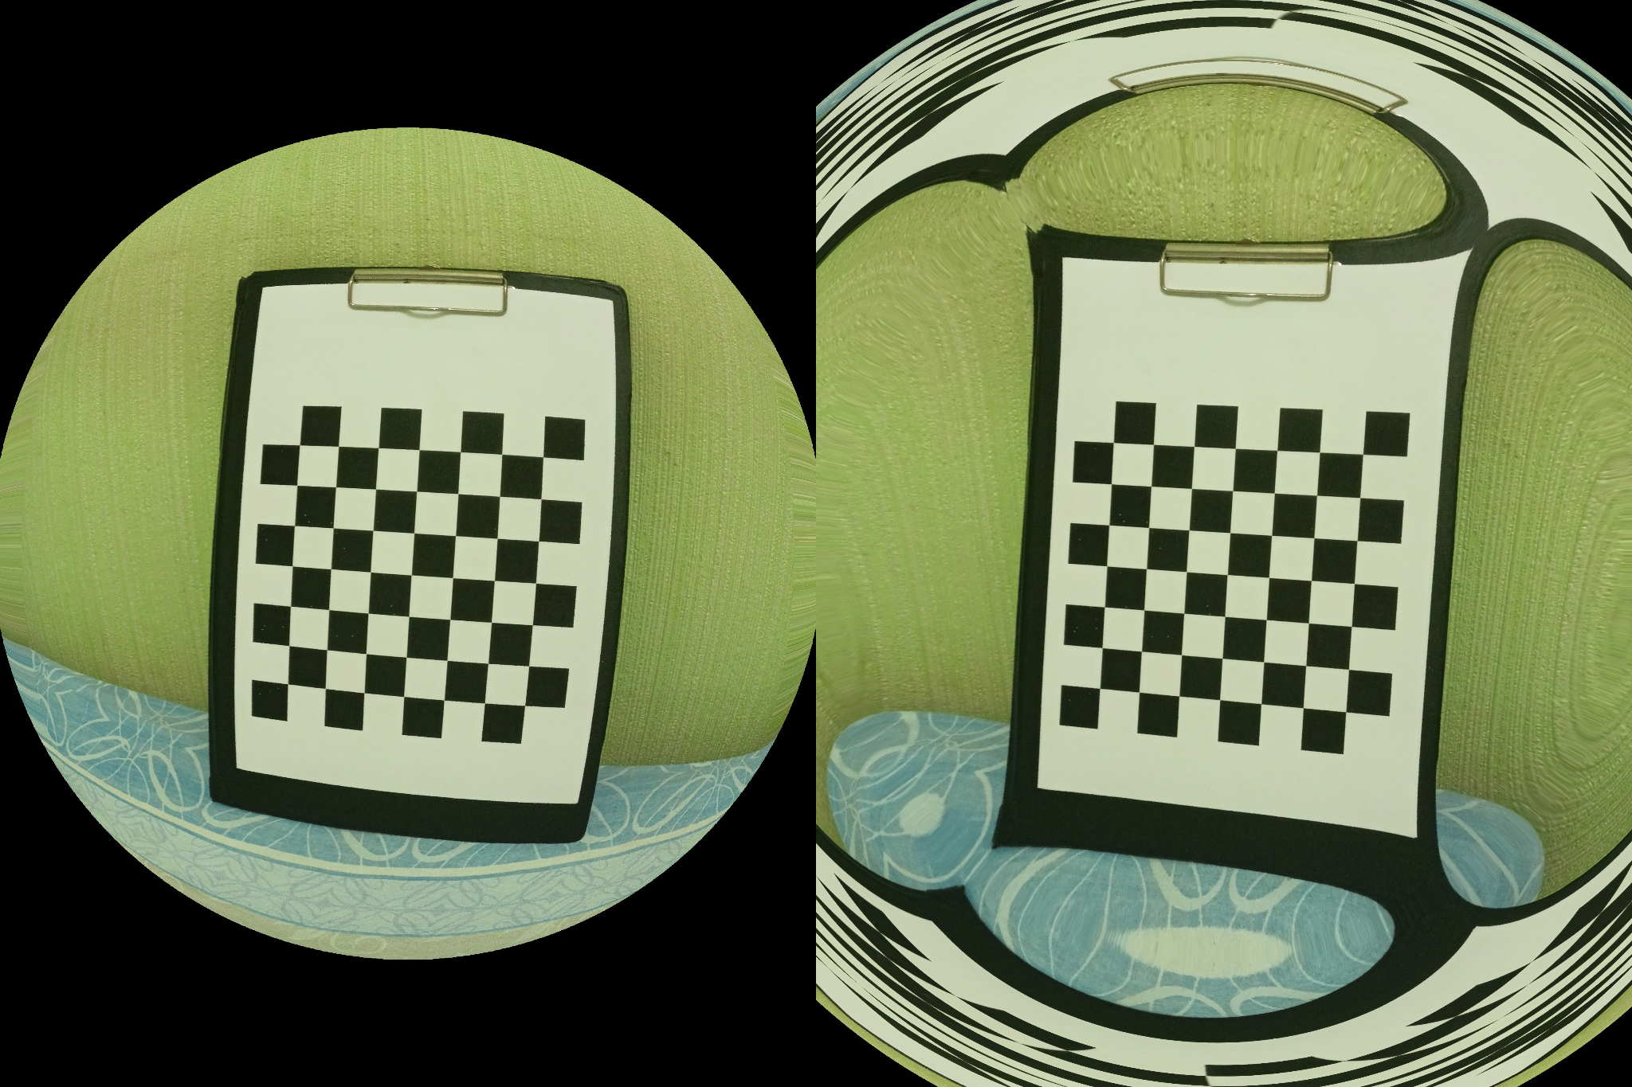
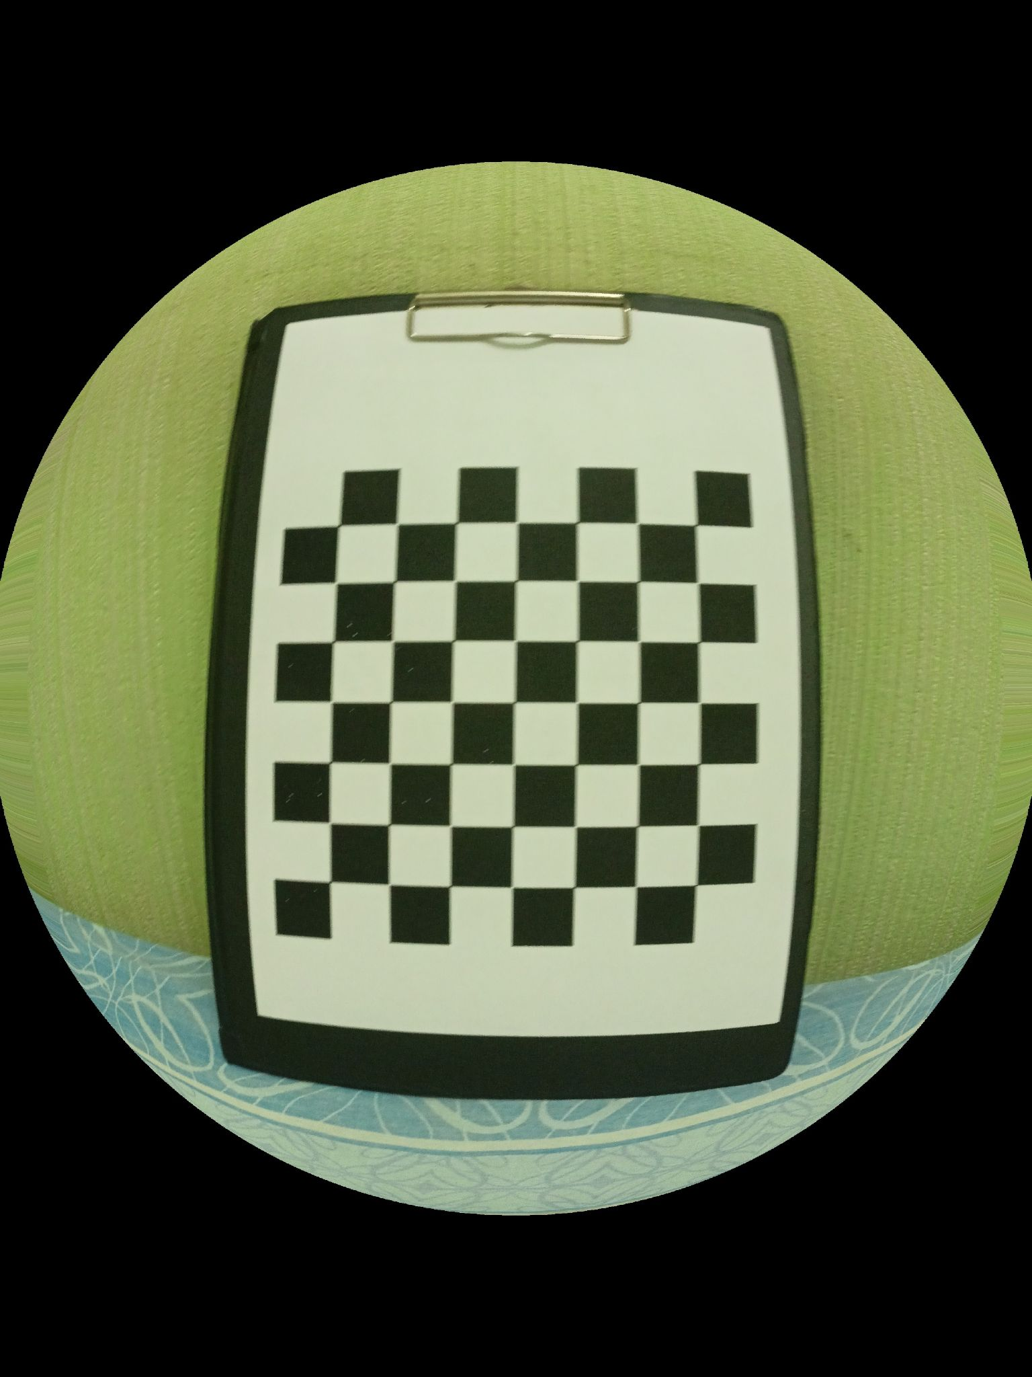
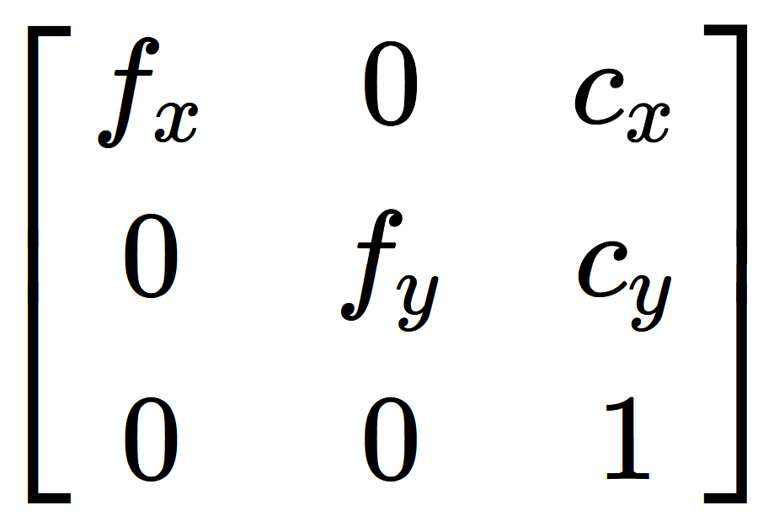
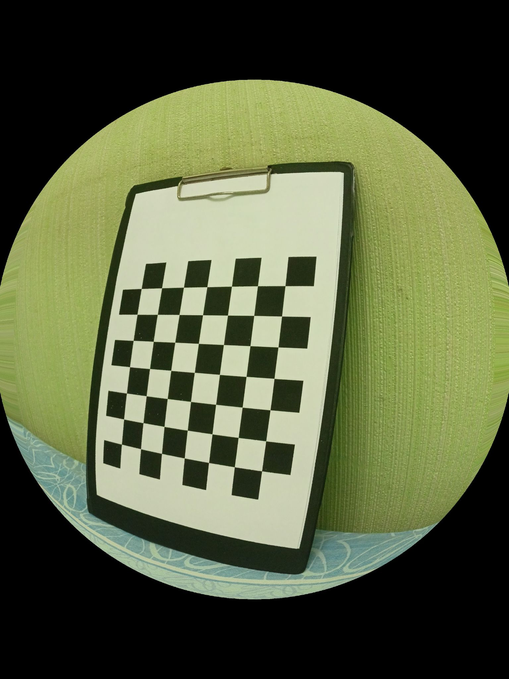
Calibration matrix

Slide 15
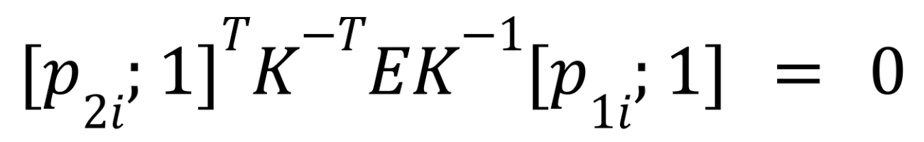
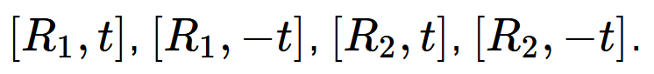
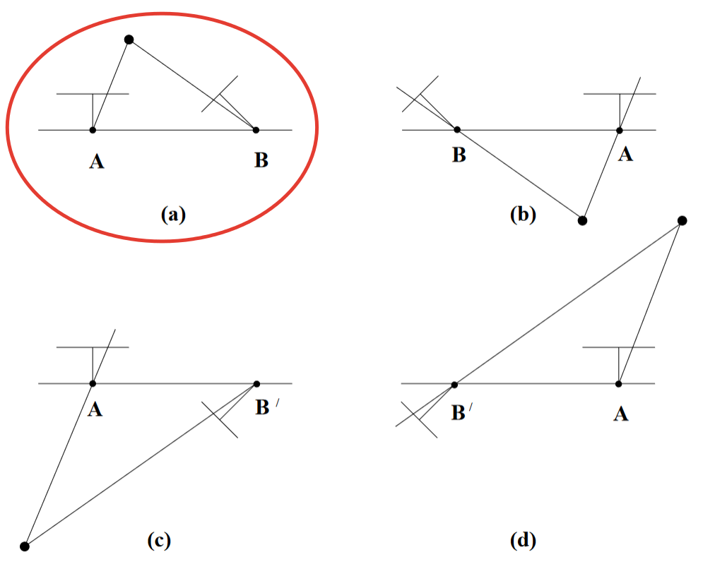
Estimating rotation and translation for the first pair
Singular value decomposition of the essential matrix
Projections have same logic for 3D

Slide 16
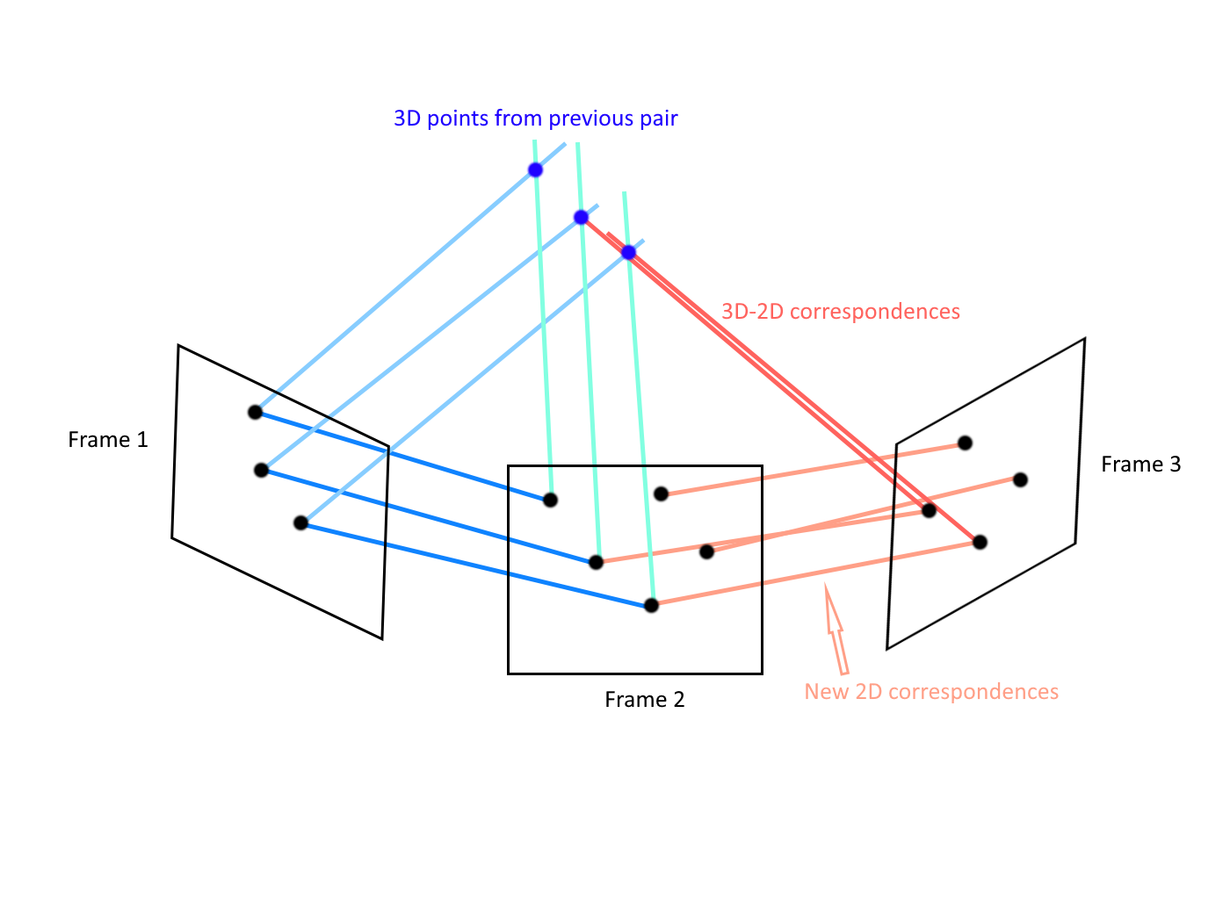
Estimating rotation and translation for the further pairs
Reprojection error minimization
No need to choose from 4 variants

Slide 17
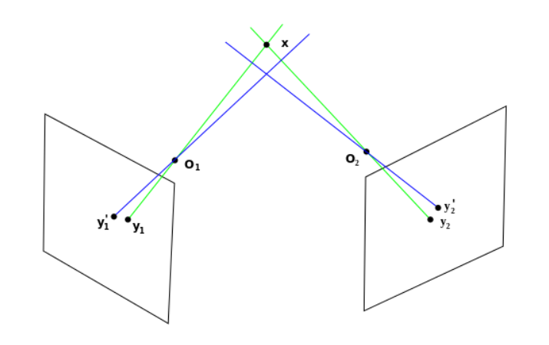
Triangulation
2D point Y1 (extracted point)
2D point Y2 (matched point)
Complex linear decomposition
3D point X
Projection matrices

Slide 18
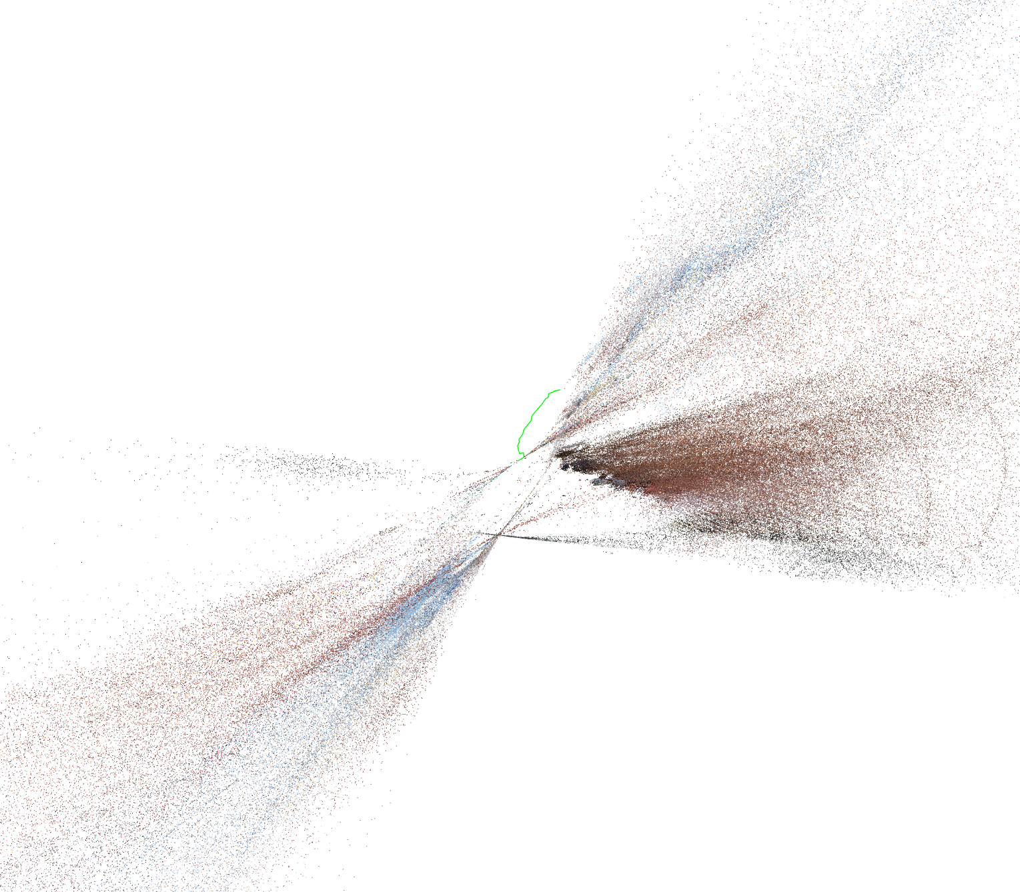
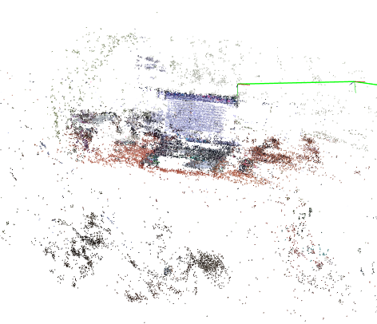
Bundle adjustment (expectations)

Slide 19
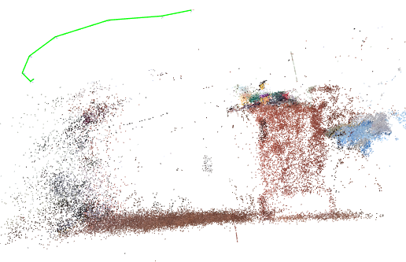
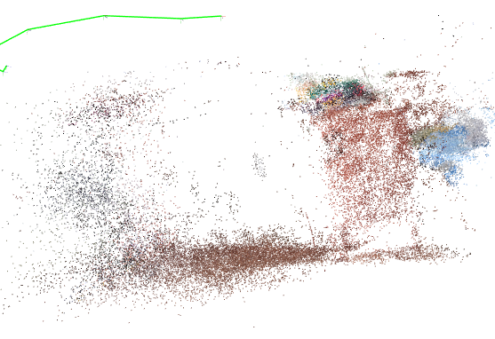
Bundle adjustment (reality)
(floor is slightly smothered, objects are collided)

Slide 20
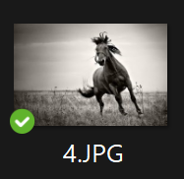
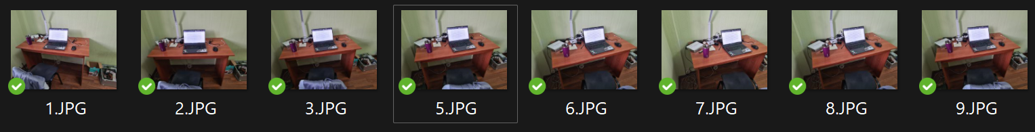
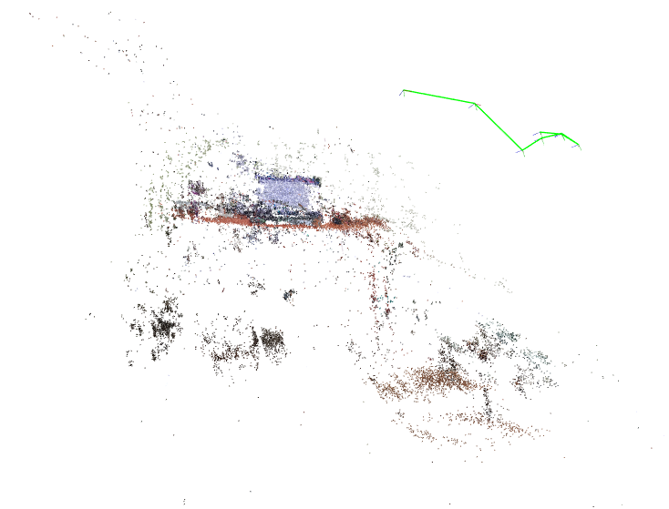
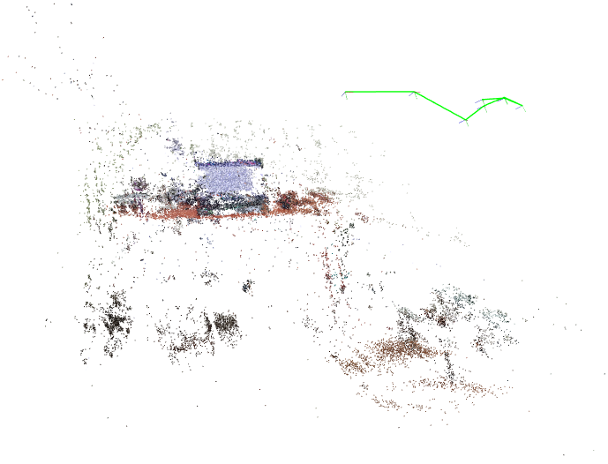
Robust main cycle
Without horse
With horse (it's ignored)

Slide 21
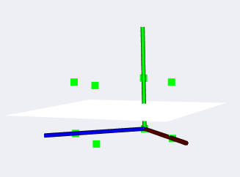
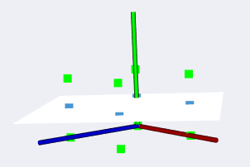
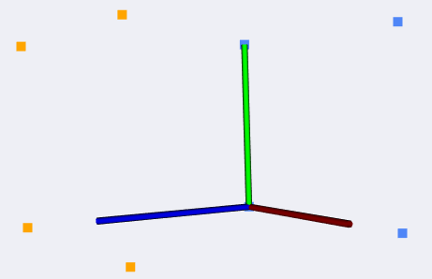
2.5D Triangulation (the one about real triangles)
3 simple steps:
Clusterize the points
(just an example)
Find best fitting plane
Project points on it

Slide 22
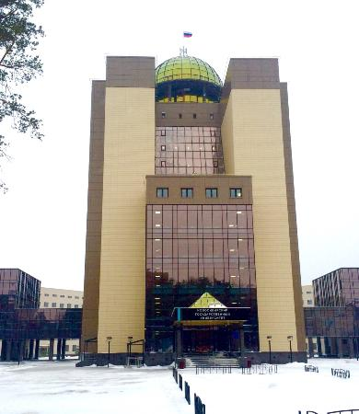
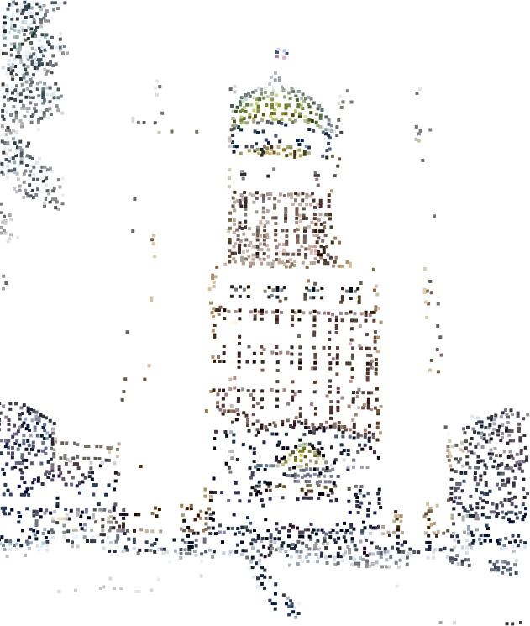
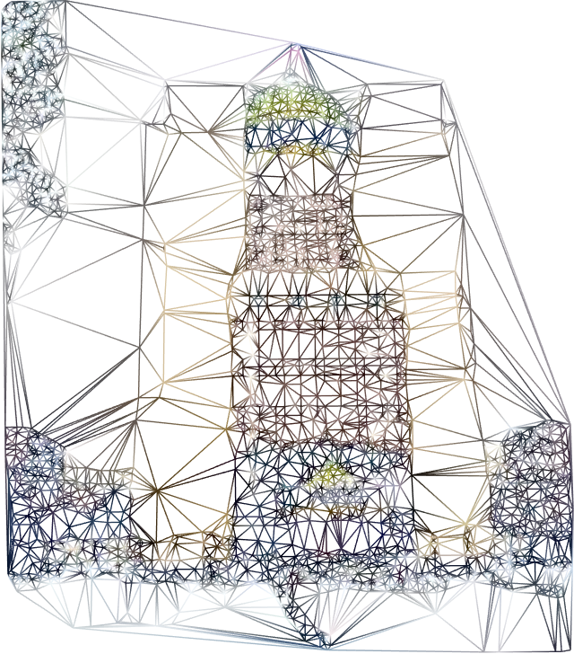
Delaunay triangulation
Source image
Extracted features
Triangulated points
(literally connected by triangles)

Slide 23
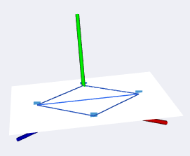
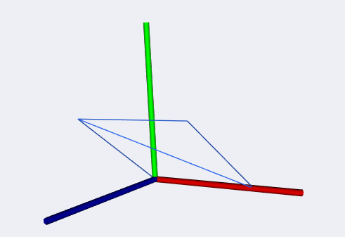
2.5D Triangulation (the one about real triangles)
Another 2 simple steps:
Triangulate points
Recover original positions

Slide 24
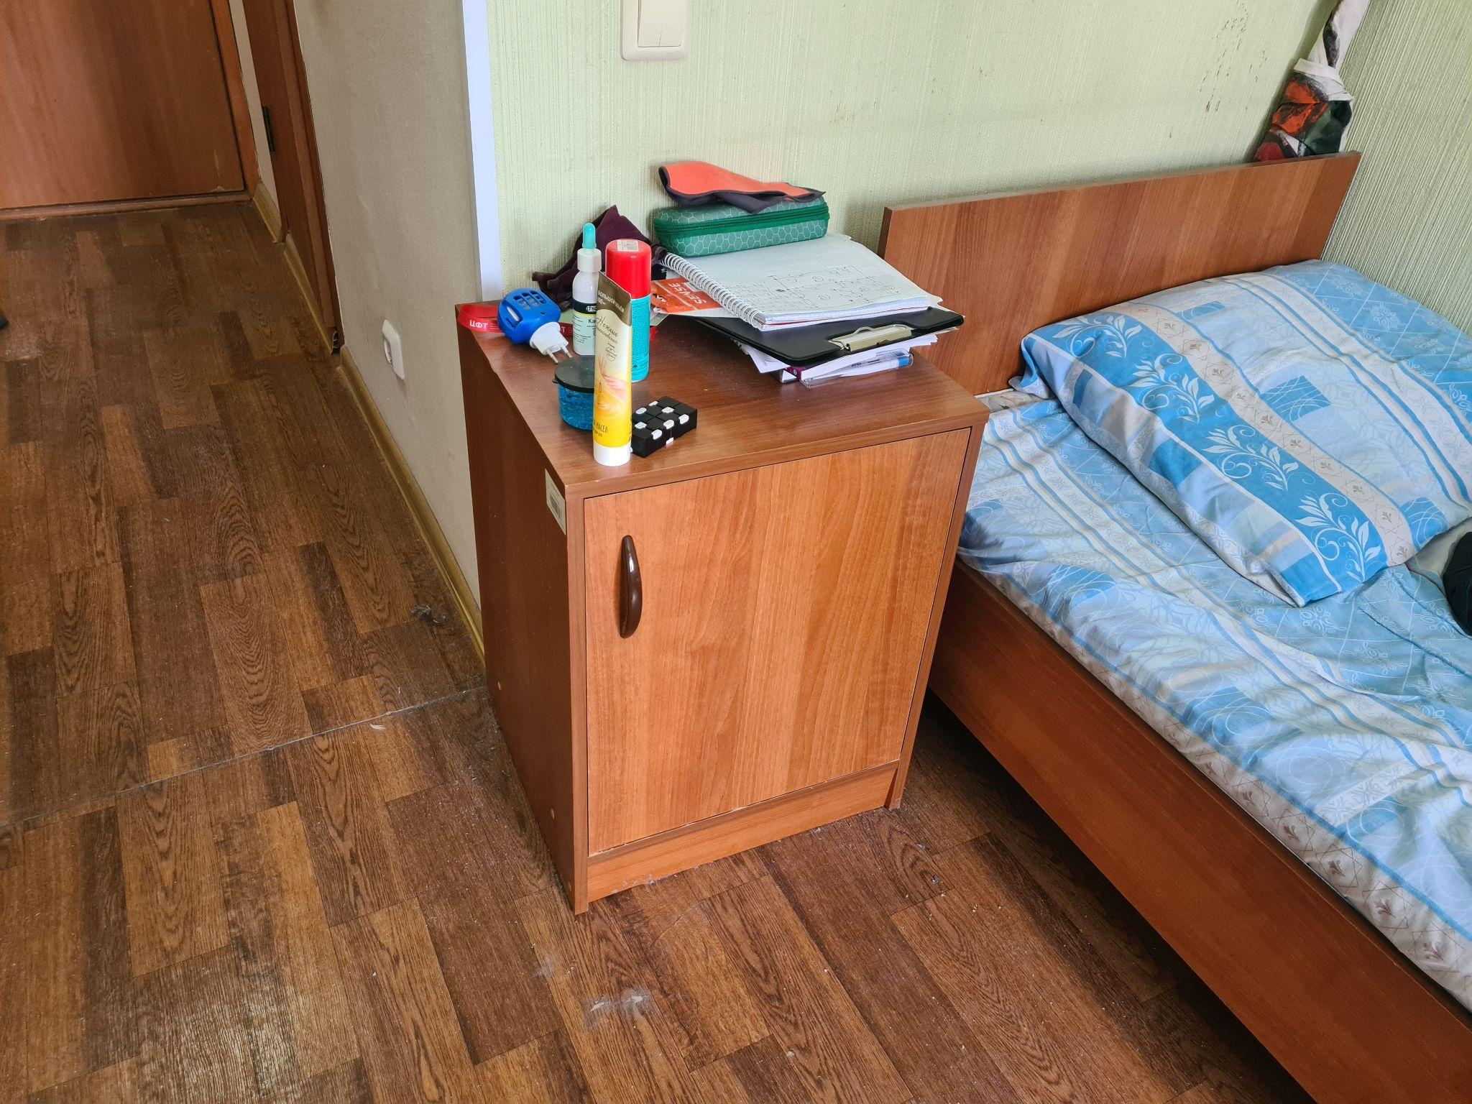
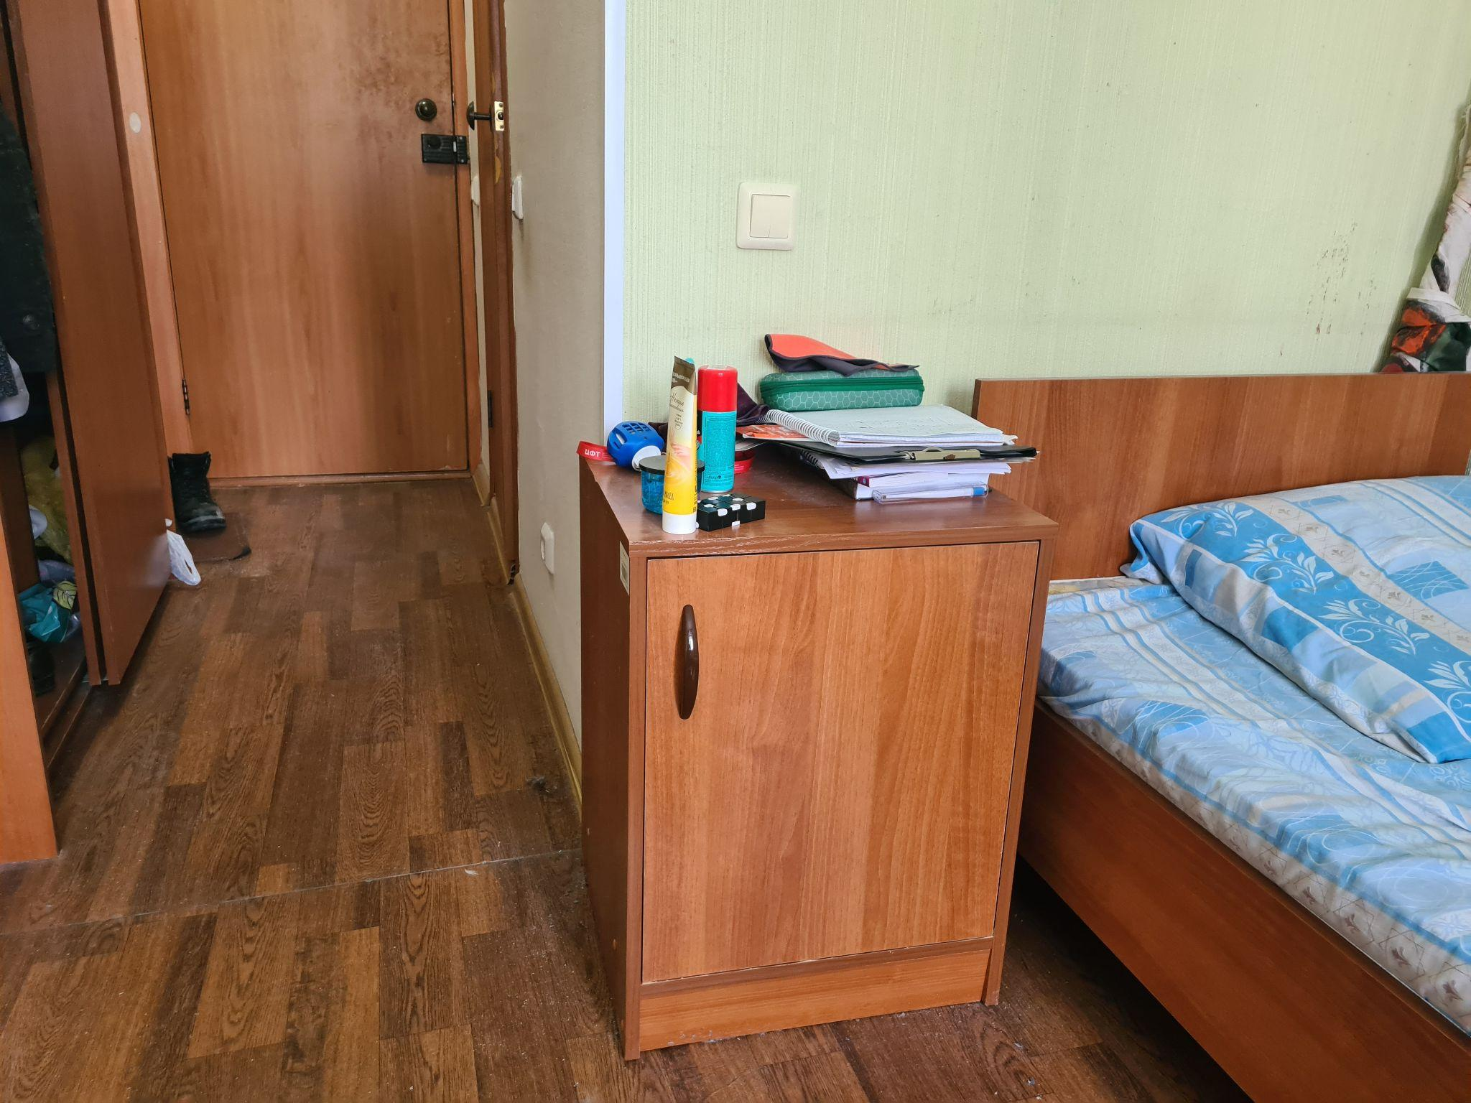
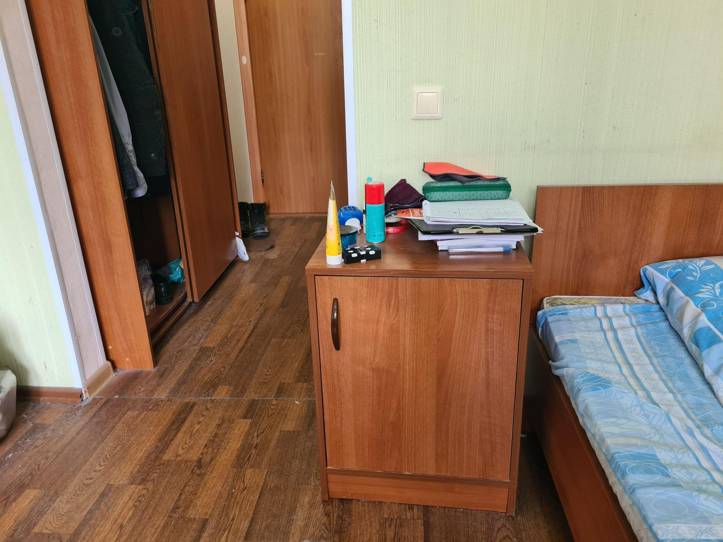
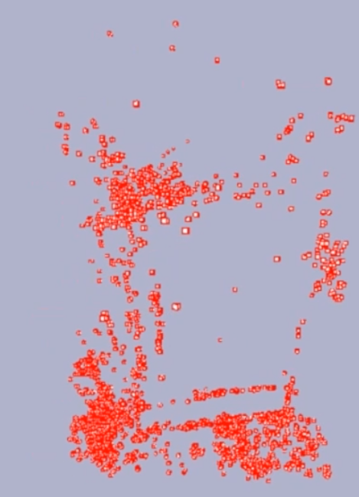
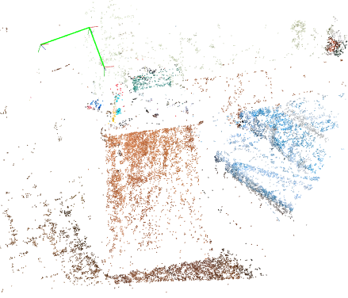
This term improvements
Increased accuracy by new transition estimation method
Speed up with the CUDA module and multithreading
New powerful visualizer with triangles
4:19
4:20

Slide 25

Conclusion
Main results:
Learnt a lot of new technologies in CV and C++
Mastered project management
Got good enough reconstruction results in some cases despite the most tedious process of selecting parameters
Interesting numbers:
477 commits
~6 GB data sources
80+ completed tasks
3 broken minds
0 desires to work with CV anymore

Slide 26


Thanks for attention!
Task board
Github
Let’s go to the demo

